Slide 1

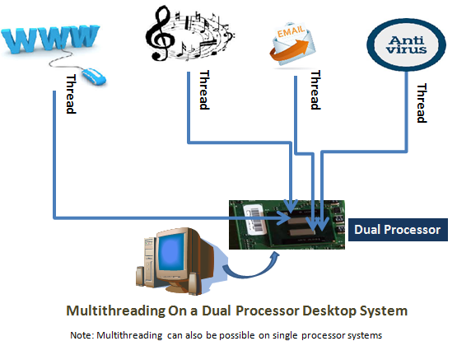
Introduction to Threads –Multithreading

Slide 2
Introduction to Threads
Thread
A small unit of code
A thread is a lightweight sub-process, the smallest unit of processing
Multithreading
Process of executing multiple thread simultaneously

Slide 3
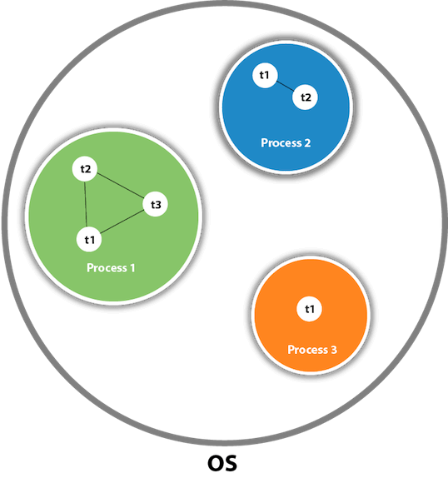
Thread in java
Threads are independent. If there occurs exception in one thread, it doesn't affect other threads. It uses a shared memory area.

Slide 4
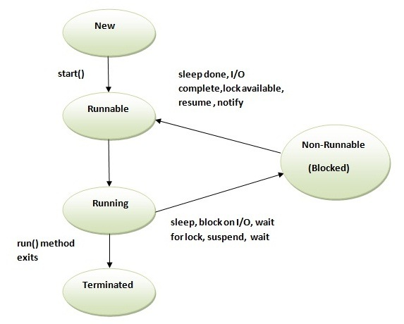
Thread Life Cycle

Slide 5
Thread Life Cycle
1) New:
The thread is in new state if you create an instance of Thread.
2) Runnable:
The thread is in runnable state after calling the start() method
3)Running :
A thread is in running state if the thread scheduler has selected it.

Slide 6
Thread Life Cycle
4) Non-Runnable (Blocked)
This is the state when the thread is still alive, but is currently not eligible to run.
5) Terminated
A thread is in terminated or dead state when its run() method exits.

Slide 7
Multithreading
Two ways of creating thread are
By extending thread class
By implementing Runnable interface
By extending thread class
New class created by extending thread class
run method is overrided
start() method is used to start the thread.

Slide 8
Example Program
class Multi_thread extends Thread{
public void run()
{
System.out.println("thread is running...");
}
public static void main(String args[])
{
Multi_thread t1=new Multi_thread();
t1.start();
}
}

Slide 9
Multithreading
By implementing Runnable interface
Class is created by implementing Runnable interface
run() method has to be implemented in subclass
Start() method is used to start the thread.

Slide 10
Example Program
class multi_runnable implements Runnable{
public void run()
{
System.out.println("thread is running...");
}
public static void main(String args[])
{
multi_runnable m1=new multi_runnable();
Thread t1 =new Thread(m1);
t1.start();
}
}

Slide 11
Thread.sleep() in Java
The method sleep() is being used to halt the working of a thread for a given amount of time.
The time up to which the thread remains in the sleeping state is known as the sleeping time of the thread.
After the sleeping time is over, the thread starts its execution from where it has left.

Slide 12
The sleep() Method Syntax:
public static void sleep(long mls) throws InterruptedException

Slide 13
Example Program
class TestSleepMethod1 extends Thread{
public void run(){
for(int i=1;i<5;i++){
// the thread will sleep for the 500 milli seconds
try{Thread.sleep(500);}
catch(InterruptedException e){System.out.println(e);}
System.out.println(i);
}
}
public static void main(String args[]){
TestSleepMethod1 t1=new TestSleepMethod1();
TestSleepMethod1 t2=new TestSleepMethod1();
t1.start();
t2.start();
}
}

Slide 14
Can we start a thread twice
No. After starting a thread, it can never be started again. If you does so, an IllegalThreadStateException is thrown.

Slide 15
Example
public class TestThreadTwice1 extends Thread{
public void run(){
System.out.println("running...");
}
public static void main(String args[]){
TestThreadTwice1 t1=new TestThreadTwice1();
t1.start();
t1.start();
}
}
running
Exception in thread "main" java.lang.IllegalThreadStateException

Slide 16
Java join() method
When the join() method is invoked, the current thread stops its execution and the thread goes into the wait state.
The current thread remains in the wait state until the thread on which the join() method is invoked has achieved its dead state.
If interruption of the thread occurs, then it throws the InterruptedException.
Syntax:public final void join() throws InterruptedException

Slide 17
Example
https://docs.google.com/document/d/1DdV53pR0Er_2_Nw_z1pQeiR5vLb8xpupo5mPD9PUXxs/edit?usp=sharing

Slide 18
Naming Thread
The Thread class provides methods to change and get the name of a thread.
By default, each thread has a name, i.e. thread-0, thread-1 and so on.
syntax
public String getName(): is used to return the name of a thread.
public void setName(String name): is used to change the name of a thread.

Slide 19
Example
class TestMultiNaming1 extends Thread{
public void run(){
System.out.println("running...");
}
public static void main(String args[]){
TestMultiNaming1 t1=new TestMultiNaming1();
TestMultiNaming1 t2=new TestMultiNaming1();
System.out.println("Name of t1:"+t1.getName());
System.out.println("Name of t2:"+t2.getName());
t1.start();
t2.start();
t1.setName("Sonoo Jaiswal");
System.out.println("After changing name of t1:"+t1.getName());
}
}

Slide 20
Thread Priority
Each thread has a priority. Priorities are represented by a number between 1 and 10. In most cases, the thread scheduler schedules the threads according to their priority
Syntax
public final int getPriority():
The java.lang.Thread.getPriority() method returns the priority of the given thread.
public final void setPriority(int newPriority):
The java.lang.Thread.setPriority() method updates or assign the priority of the thread to newPriority.

Slide 21
Example
https://docs.google.com/document/d/199BipwBErURQZXqUOf9DAFKrgwYfyO2DS29y1JWeZE0/edit?usp=sharing

Slide 22
Synchronization in Java
Synchronization in Java is the capability to control the access of multiple threads to any shared resource.

Slide 23
Thread Synchronization
There are two types of thread synchronization are
Mutual Exclusive
Synchronized method.
Synchronized block.
Static synchronization.
Cooperation (Inter-thread communication in java)

Slide 24
Mutual Exclusive-Examples
https://docs.google.com/document/d/1SgvW7YEBmMxR-7M6_h_IfE-wac_9R3DXYU3wsBjZKRM/edit?usp=sharing

Slide 25
Inter-thread Communication
Inter-thread communication or Co-operation is to allow synchronized threads to communicate with each other.
It is implemented by following methods of Object class:
wait()
notify()
notifyAll()

Slide 26
Inter-thread Communication
wait() method
The wait() method causes current thread to release the lock and wait until either another thread invokes the notify() method or the notifyAll() method
notify() method
The notify() method wakes up a single thread that is waiting on this object's monitor.
notifyAll() method
Wakes up all threads that are waiting on this object's monitor.

Slide 27
Example
https://docs.google.com/document/d/1BLWhZcb9atR20-1HEuKjqS3-mIHDepweNEwPakJ-ypA/edit?usp=sharing

